Slide 1
The Decision Tool for MPP-Dairy
Mark Stephenson
Director of Dairy Policy Analysis
University of Wisconsin

Slide 2
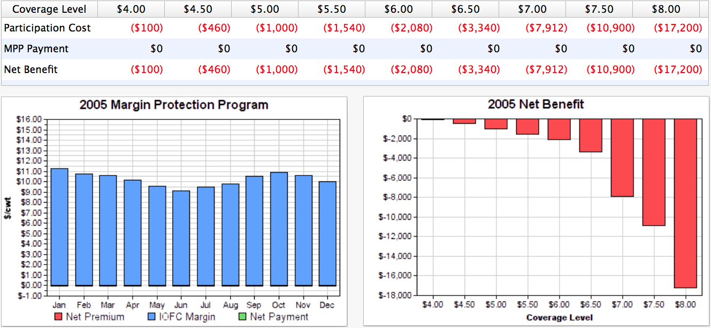
Let’s Look Back in Time
2005
175 Cows, producing 23,000 lbs of milk per cow, or 4 million annual production history

Slide 3
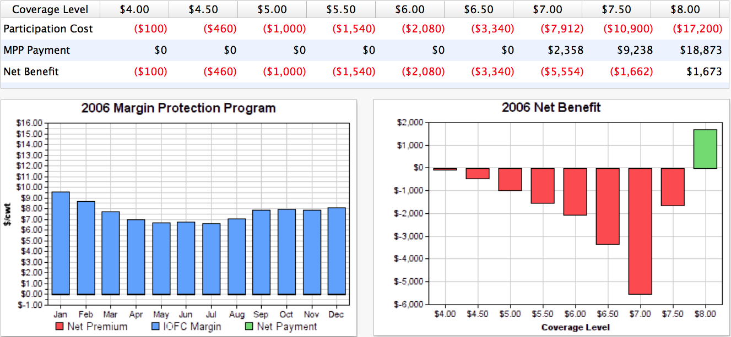
Let’s Look Back in Time
2006
175 Cows, producing 23,000 lbs of milk per cow, or 4 million annual production history

Slide 4
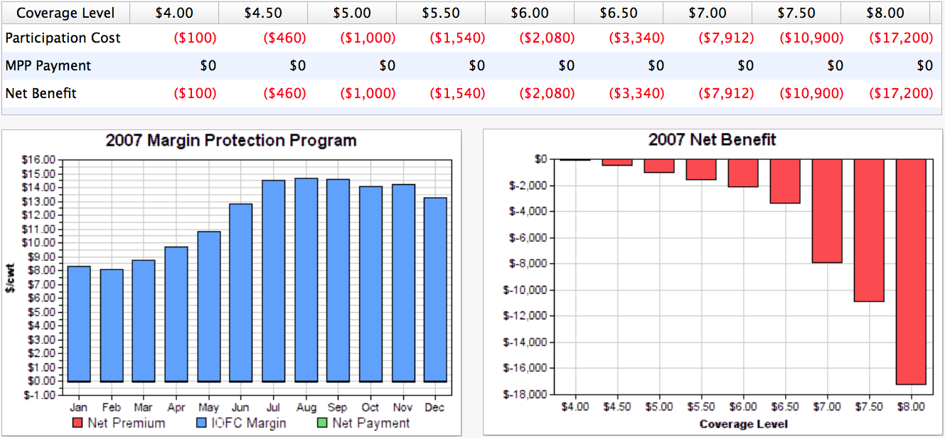
Let’s Look Back in Time
2007
175 Cows, producing 23,000 lbs of milk per cow, or 4 million annual production history

Slide 5
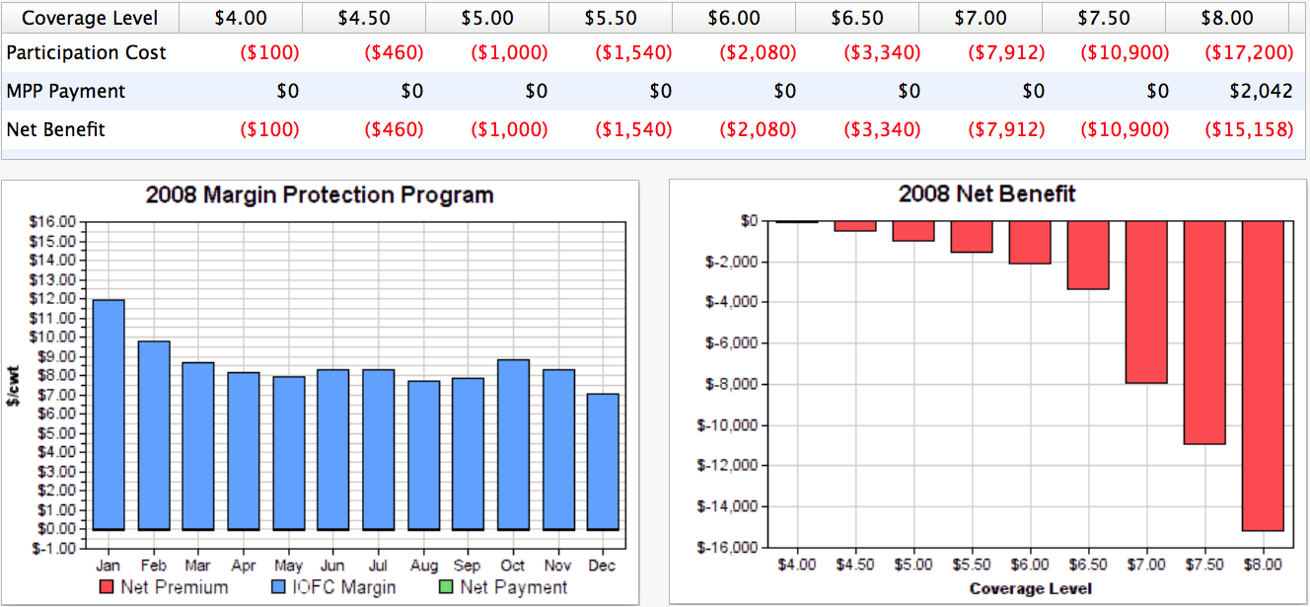
Let’s Look Back in Time
2008
175 Cows, producing 23,000 lbs of milk per cow, or 4 million annual production history

Slide 6
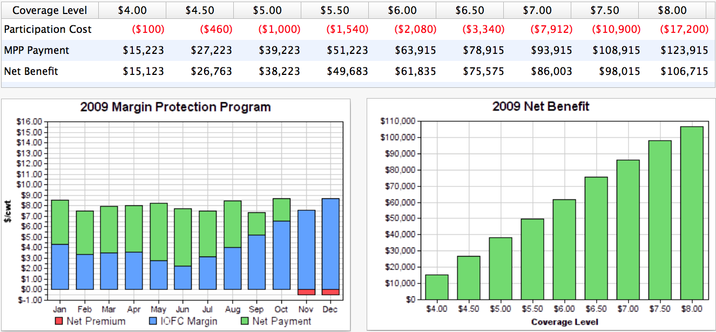
Let’s Look Back in Time
2009
175 Cows, producing 23,000 lbs of milk per cow, or 4 million annual production history
MILC paid this farm $44,800 that year.

Slide 7
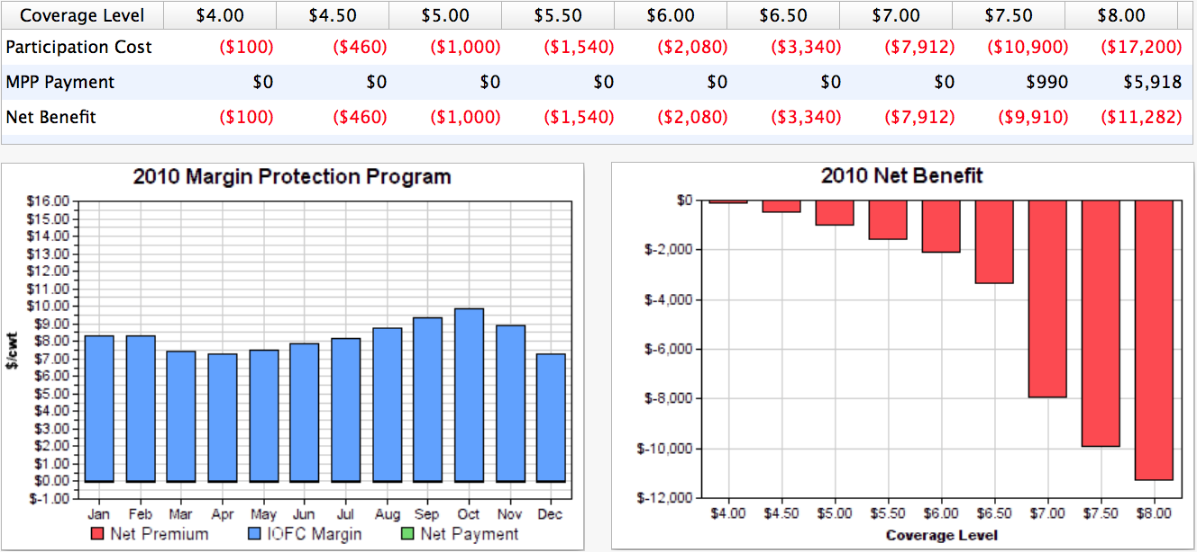
Let’s Look Back in Time
2010
175 Cows, producing 23,000 lbs of milk per cow, or 4 million annual production history

Slide 8
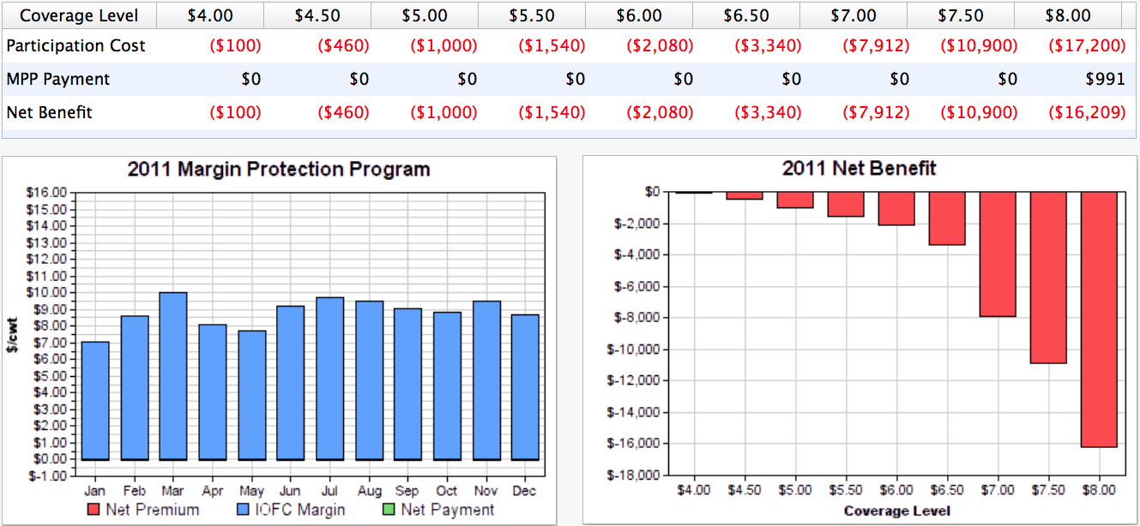
Let’s Look Back in Time
2011
175 Cows, producing 23,000 lbs of milk per cow, or 4 million annual production history

Slide 9
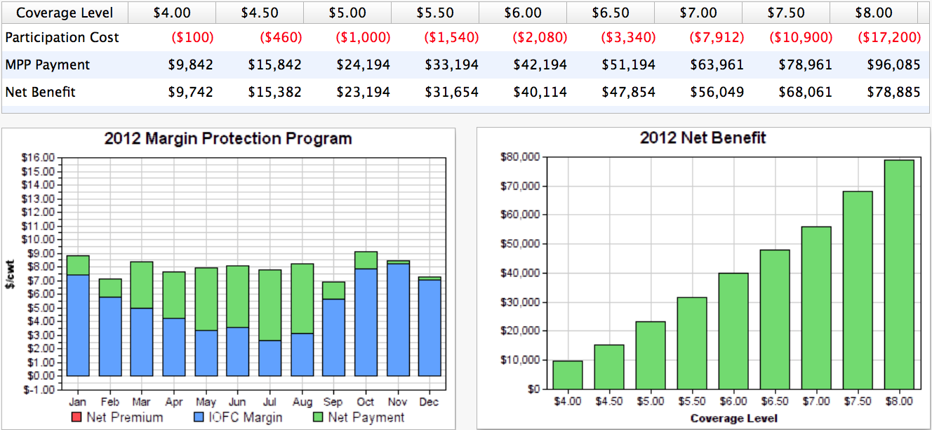
Let’s Look Back in Time
2012
175 Cows, producing 23,000 lbs of milk per cow, or 4 million annual production history
MILC paid this farm $29,000 that year.

Slide 10
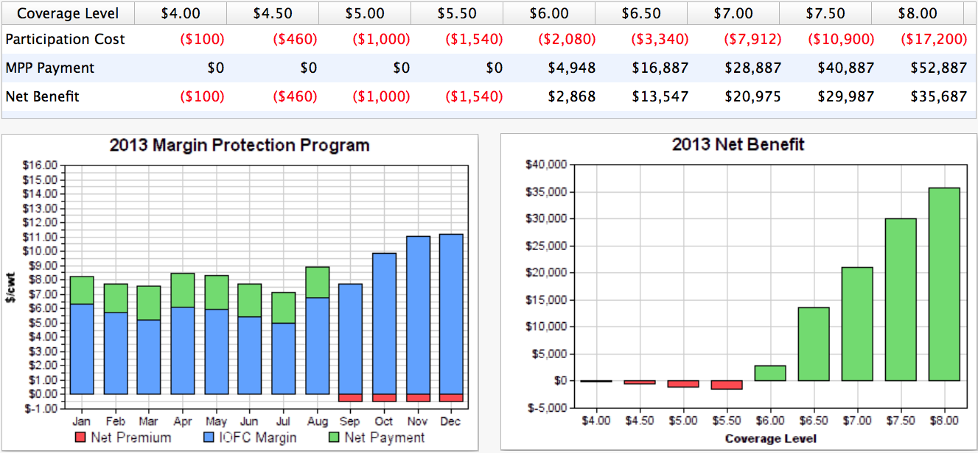
Let’s Look Back in Time
2013
175 Cows, producing 23,000 lbs of milk per cow, or 4 million annual production history
MILC paid this farm $10,300 that year.

Slide 11
If We Picked the Optimal Strategy
Year | Optimal Strategy | Optimal Outcome
2005 | $4.00 | -$100
2006 | $8.00 | $1,673
2007 | $4.00 | -$100
2008 | $4.00 | -$100
2009 | $8.00 | $106,715
2010 | $4.00 | -$100
2011 | $4.00 | -$100
2012 | $8.00 | $78,885
2013 | $8.00 | $35,687
2014 | $4.00 | -$100
 | Total | $224,137
 | per cow | $128.08
 | per cwt | $0.56

Slide 13
If We Picked Advanced Strategy
Year | Advance Strategy | Advance Outcome
2005 | $4.00 | -$100
2006 | $4.00 | -$100
2007 | $6.00 | -$2,080
2008 | $6.00 | -$2,080
2009 | $8.00 | $106,715
2010 | $4.00 | -$100
2011 | $8.00 | -$16,209
2012 | $6.50 | $48,004
2013 | $6.50 | $14,930
2014 | $4.00 | -$100
 | Total | $148,880
 | per cow | $85.07
 | per cwt | $0.37

Slide 14
If We Picked Risk Strategy
Year | Advance Strategy | Advance Outcome
2005 | $6.50 | ($3,340)
2006 | $6.50 | ($3,340)
2007 | $6.50 | ($3,340)
2008 | $6.50 | ($3,340)
2009 | $6.50 | $75,574
2010 | $6.50 | ($3,340)
2011 | $6.50 | ($3,340)
2012 | $6.50 | $48,004
2013 | $6.50 | $14,930
2014 | $6.50 | ($3,340)
 | Total | $115,128
 | per cow | $65.79
 | per cwt | $0.29

Slide 15
For More Information
http://DairyMarkets.org
http://FSA.USDA.gov

